Slide 1
Minimal API’s with .NET 7.0
Craig Jeffords

Slide 2
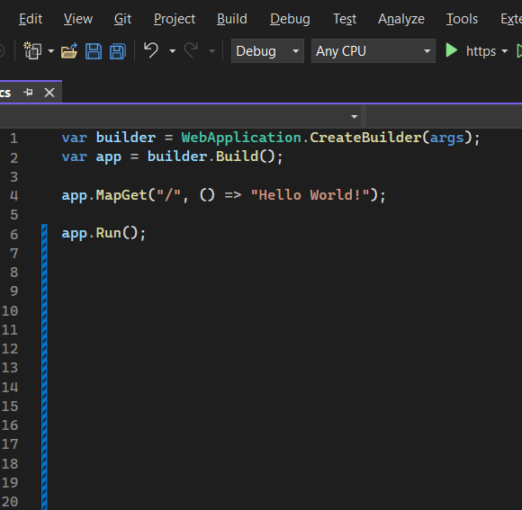
Introduction
Minimal APIs Overview
Demo
What’s New in .NET 7

Slide 3

WE DRIVE BUSINESS OUTCOMES THROUGH TECHNOLOGY
Future-Proof Your Foundation
Conquer the Cloud
Enable Digital Work
Transform Business Process
Build Competitive Products
Connect People to Data
Bulletproof Your Business
Evolve Your Security Foundation

Slide 4


Slide 5
What Are Minimal APIs
An alternative way to create HTTP APIs in .NET with minimal dependencies
Provide a way to spin up APIs with very little code
Initial reaction was positive but guarded. Some like the simplicity of them, others felt features were too limited
Notes:
Introduced with .NET 6

Slide 6
Let’s Create An API
Notes:
New project, API, uncheck “use controllers” to do minimal API
Show the default project (weather forecast). Explain how the forecast array is being created.
Show how we can

Slide 7
Create New Solution
Use Visual Studio 2022
Can also use VS Code and .NET CLI (dotnet new web)
Project template: ASP.NET Core Empty
Give your project a name and click ‘Next’
On the “Additional Information” view:
Select .NET 7.0
Uncheck “Do not use top-level statements”
Click “Create”
Notes:
Talk about the created program.cs class.
Creates a WebApplicationBuilder and a WebApplication with preconfigured defaults
Creates an HTTP GET endpoint at root “/” that returns “Hello World” in the browser

Slide 8
WebApplicationBuilder vs. WebApplication
var app = WebApplication.Create(args) will create a WebApplication without explicitly creating a WebApplicationBuilder with preconfigured defaults.
UseDevelopmentExceptionPage is added first when HostingEnvironment = “Development”
UseRouting is added second if the developer hasn’t already called it and if there are endpoints configured.
UseEndpoints is added at the end of the middleware pipeline if any endpoints are configured
UseAuthentication is added after UseRouting if the developer hasn’t already called it and IAuthenticationSchemeProvider is detected in the service provider
UseAuthorization is added next if the developer hasn’t already called it and IAuthorizationHandlerProvider is detected in the service provider
Developer-configured middleware and endpoints are added between UseRouting and UseEndpoints
Notes:
While you CAN use WebApplication.Create(), I choose to use WebApplicationBuilder to have more control over which features are included

Slide 9
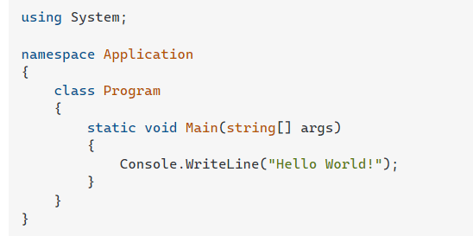
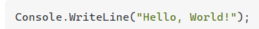
Top Level Statements
Allow code to be written directly at the root of a file without the need to wrap it in a class or method.
Notes:
Talk about the difference between top level and traditional, then show the simple solution and what each line is doing.

Slide 10
Route Handler Options
Lambda Expressions
Local Functions
Instance Methods
Static Methods
Defined outside of Program.cs
Notes:
Add /that, /lambda, /local, /instance, /static, /external, and /external/{id}

Slide 11
Adding More Functionality
Swagger: To test our endpoints
Entity Framework: In-memory database and models
Logging: Serilog console and file logging
Endpoints (games and teams):
GET by id
PUT
POST
DELETE
Notes:
Walk them through example 2, showing how I added dbcontext, swagger and logging
Show the console window after hitting an endpoint. Also show the log file.
Explain the game/team relationship and how endpoints will allow management of data (get all, get by id, update that game score, get all, get by id)

Slide 12
Features Added in .NET 7
Endpoint Filters:
Use EndpointFilterInvocationContext to access HttpContext and the argument list.
Native log provider
Logging is provided natively in .NET 7 but I prefer to use Serilog
Route Groups:
Divide related endpoints into groups and define the group route
Typed results:
Return strongly typed results from endpoints
Notes:
Show patch endpoint for updating scores (finals can’t be ties)
Show example 3 to demonstrate route groups and typed results

Slide 13
What Comes Next?
Add authentication/authorization
Add unit tests
Add global exception handling
Improve OpenApi implementation

Slide 14
THANK YOU!
Notes:
Thanks for coming
Hope everybody got “something” out of this.

Slide 15
Useful Links
Minimal APIs Quick Reference: https://learn.microsoft.com/en-us/aspnet/core/fundamentals/minimal-apis?view=aspnetcore-7.0
Tutorial: Create a minimal API with ASP.NET Core: https://learn.microsoft.com/en-us/aspnet/core/tutorials/min-web-api?view=aspnetcore-7.0&tabs=visual-studio

Slide 16


